Slide 1

Marketing campaing analysis
FILIPE CHAVES DE MACEDO

Slide 2
INTRODUCTION
With the objective of helping the marketing department to spend its annual budget in a more assertive way, we made a brief case study based on past campaigns, where we want to know the customers and also some insights that may be useful.
Main topics on the next slides:
Past campaigns overview;
Customer’s profile;
Customer segmentation – RFM;
Customer segmentation – Kmeans;
Predictive model to improve de campaign’s profit.

Slide 3
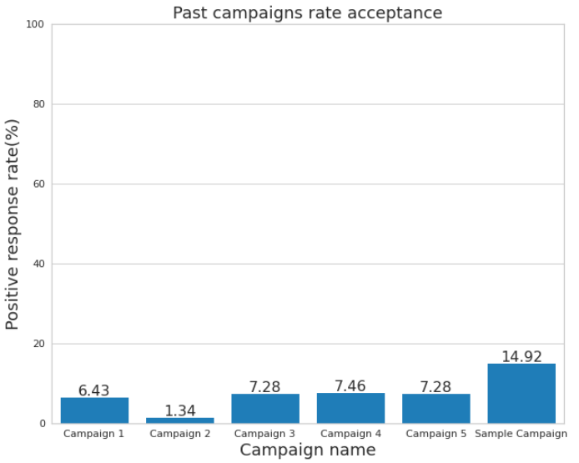
PAST Campaigns ANALYSIS
Below we can see the graph that shows the rate of positive responses in each campaign already carried out, 2240 responses were analyzed and the campaign with the highest sales conversion rate was the Sample Campaign with a percentage of 15,03%, with this data we can visualize that the effectiveness of the campaigns has been extremely low.
ATTENTION POINT:
In the sample campaign the marketing department spent 6.720MU and the revenue generated was 3.674MU, globaly the campaign had a profit of -3.046MU.

Slide 4
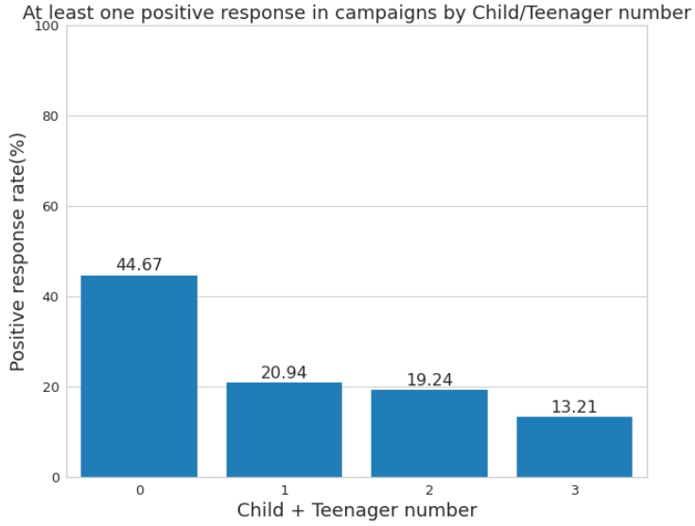
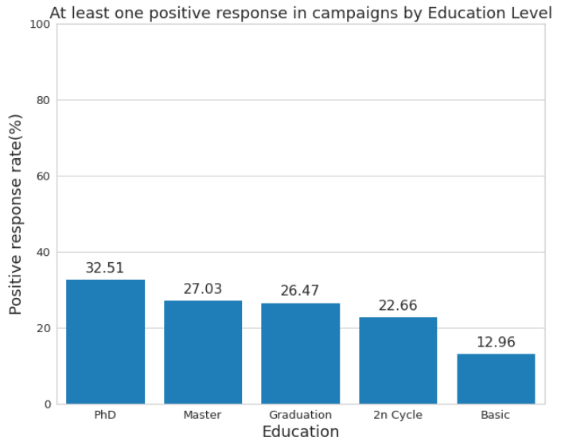
CUSTOMER’S PROFILE
Trying to better understand the profile of consumers, who accepted at least one offer in past campaigns, we analyzed the percentage of positive responses taking into account some characteristics that we will see below.
An interesting characteristic that can be seen with this analysis is that customers who do not have children or teenagers at home accepted offers from past campaigns in a greater proportion when compared to people who have one or more children or teenagers at home. Another interesting point is that people with a high education level accepted the past campaigns in a great proportion when compared with low education levels.

Slide 5
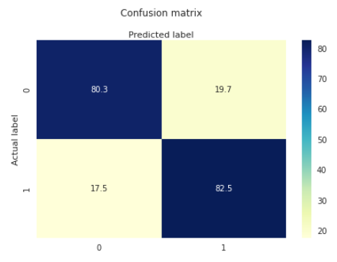
Predictive model
In the prediction we will use a Logistic Regression to make classification between customers who will accept the campaign offer in the next campaign

Slide 6
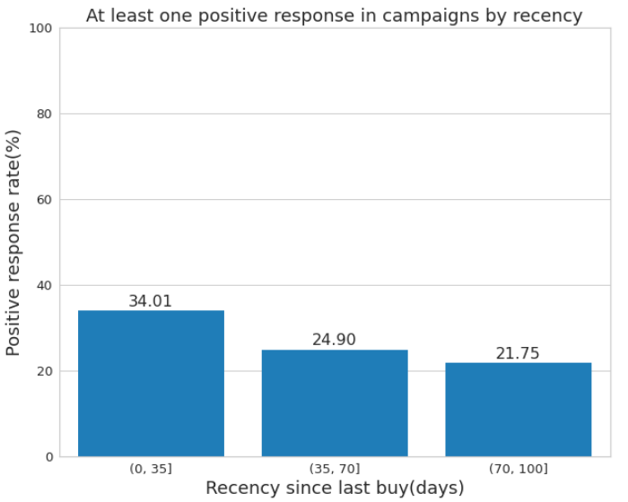
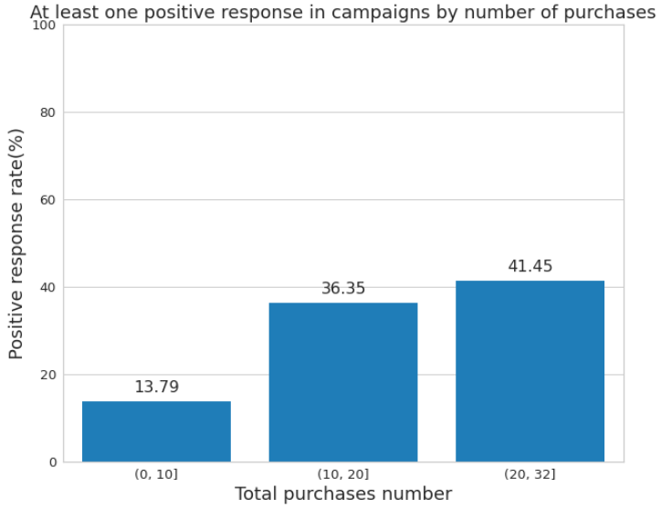
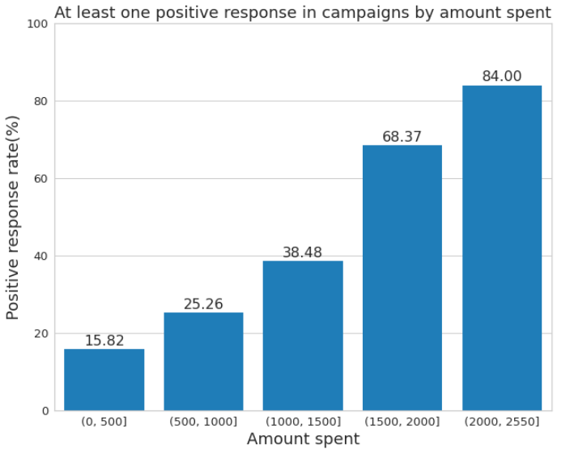
CUSTOMER SEGMENTATION - RFM
In the charts below, we can see that customers who bought more recently, more frequently and who spent more shopping have in common the characteristic of accepting marketing campaigns at a higher rate.
Based on this information we will perform customer segmentation using the RFM(Recency, Frequency, Monetary) method which is based on how recently, how often and how much a customer has purchased, from these three variables the customer receives a score that will define which group he will be allocated to.

Slide 7
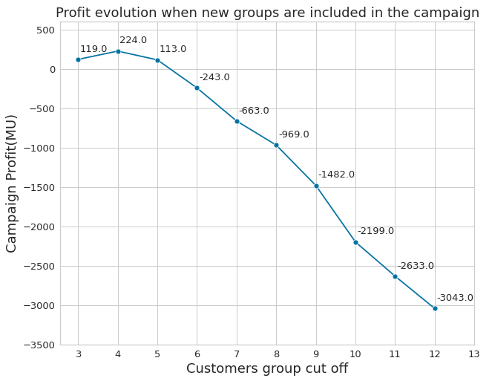
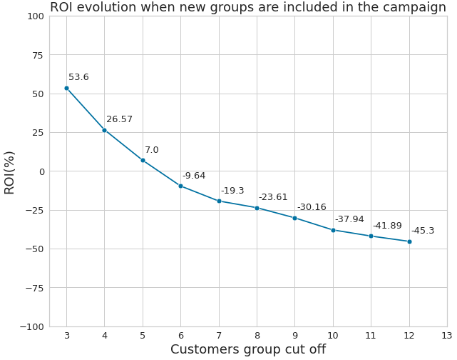
CUSTOMER SEGMENTATION - RFM
With the RFM segmentation were created ten customer groups, from the best(score 3) to the worse(score 12), starting with the best score we included group by group in the campaign analyzing the impact in two main factors the Profit and the ROI.
We can see that if we include just the groups with scores 3 and 4 in the campaign we can reach our best profit in 224MU.
The best ROI of 53,6% is when we have just the customers with score 3 being contacted, this occurs because this group has the best buying per contact rate.

Slide 8
CUSTOMER SEGMENTATION - RFM
Bellow we can see the table with all the data including campaign costs, sold gadgets and revenue.
RFM Score | Customers in the group | Contacted customers | Campaign cost (MU) | Sold gadgets | Campaign revenue (MU) | Group Profit | Profit (MU) | ROI(%)
3 | 74 | 74 | 222 | 31 | 341 | 119 | 119 | 53,6
4 | 207 | 281 | 843 | 97 | 1067 | 105 | 224 | 26,57
5 | 257 | 538 | 1614 | 157 | 1727 | -111 | 113 | 7
6 | 302 | 840 | 2520 | 207 | 2277 | -356 | -243 | -9,64
7 | 305 | 1145 | 3435 | 252 | 2772 | -420 | -663 | -19,3
8 | 223 | 1368 | 1404 | 285 | 3135 | -306 | -969 | -23,61
9 | 270 | 1638 | 4914 | 312 | 3432 | -513 | -1482 | -30,16
10 | 294 | 1932 | 5796 | 327 | 3597 | -717 | -2199 | -37,94
11 | 163 | 2095 | 6285 | 332 | 3652 | -434 | -2633 | -41,89
12 | 144 | 2239 | 6717 | 334 | 3674 | -410 | -3043 | -45,3

Slide 9
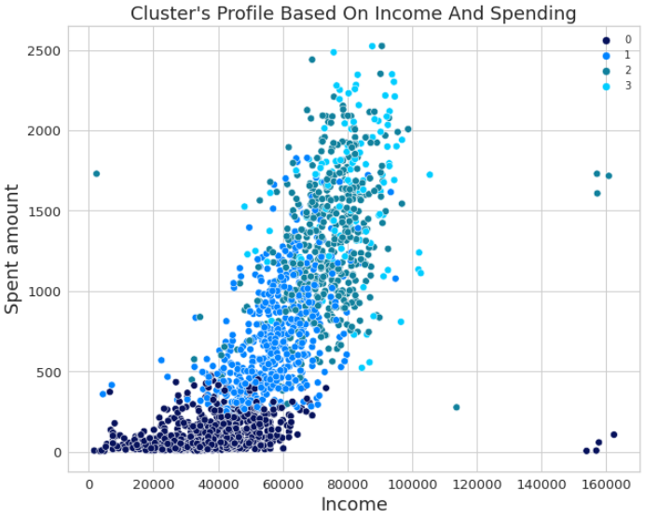
CUSTOMER SEGMENTATION - KMEANS
Another method we used to segment customers was Kmeans, which is able to separate samples in n groups of equal variance. According to the method used, the best number of groups to segment customers is four.
Group number | Customers in the group | Campaign cost (MU) | Sold gadgets | Campaign revenue (MU) | Profit (MU) | ROI(%)
0 | 1038 | 3114 | 91 | 1001 | -2113 | -67,85
1 | 579 | 1737 | 70 | 770 | -967 | -55,67
2 | 501 | 1503 | 94 | 1034 | -469 | -31,20
3 | 121 | 363 | 79 | 869 | 506 | 139,39
We can see that among the four groups, only one had a positive return of 506MU, where 121 customers were contacted and 79 gadgets were sold. If the campaign was made only with users in this group, the ROI would be 139,39%. Analyzing the characteristics of this group we have an idea of what makes it different from the others this group has higher medians in income, total spend, number of purchases and positive responses in previous marketing campaigns. We noticed that most of the clients in the group don't have children or teenagers at home

Slide 10
CUSTOMER SEGMENTATION - KMEANS
Another method we used to segment customers was Kmeans, which is able to separate samples in n groups of equal variance. According to the method used, the best number of groups to segment customers is four.
Group number | Customers in the group | Campaign cost (MU) | Sold gadgets | Campaign revenue (MU) | Profit (MU) | ROI(%)
0 | 1038 | 3114 | 91 | 1001 | -2113 | -67,85
1 | 579 | 1737 | 70 | 770 | -967 | -55,67
2 | 501 | 1503 | 94 | 1034 | -469 | -31,20
3 | 121 | 363 | 79 | 869 | 506 | 139,39
We can see that among the four groups, only one had a positive return of 506MU, where 121 customers were contacted and 79 gadgets were sold. If the campaign was made only with users in this group, the ROI would be 139,39%. Analyzing the characteristics of this group we have an idea of what makes it different from the others this group has higher medians in income, total spend, number of purchases and positive responses in previous marketing campaigns. We noticed that most of the clients in the group don't have children or teenagers at home

